Slide 1
Data Science Project
Presented by:
Sai Charan Guttikonda
Sai Nitin Bhadriraju
DSCI-490-001

Slide 2

About Prospera
Prospera Credit Union (Prospera) is a British Columbia-based organization that offers various financial services, including personal banking, business banking, and wealth management.
In addition, the company offers various online banking services including mobile banking, interac e-transfer, prosperity tracker, and payment services via Apple pay, Google pay, and Samsung pay.
In January 2020, Prospera merged with Westminster Savings Credit Union, a full-service financial institution offering personal financial services products and services. The company operates a network of 29 branches, online and mobile banking, the exchange ATM network, and a contact center. The company serves approximately 120,000 members and manages around $9 billion worth of assets.

Slide 3
Exploratory Data Analysis

Slide 4
Gender
👩49%
👨51%
Age Category

Slide 5
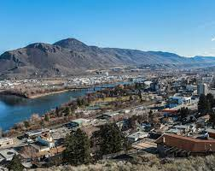
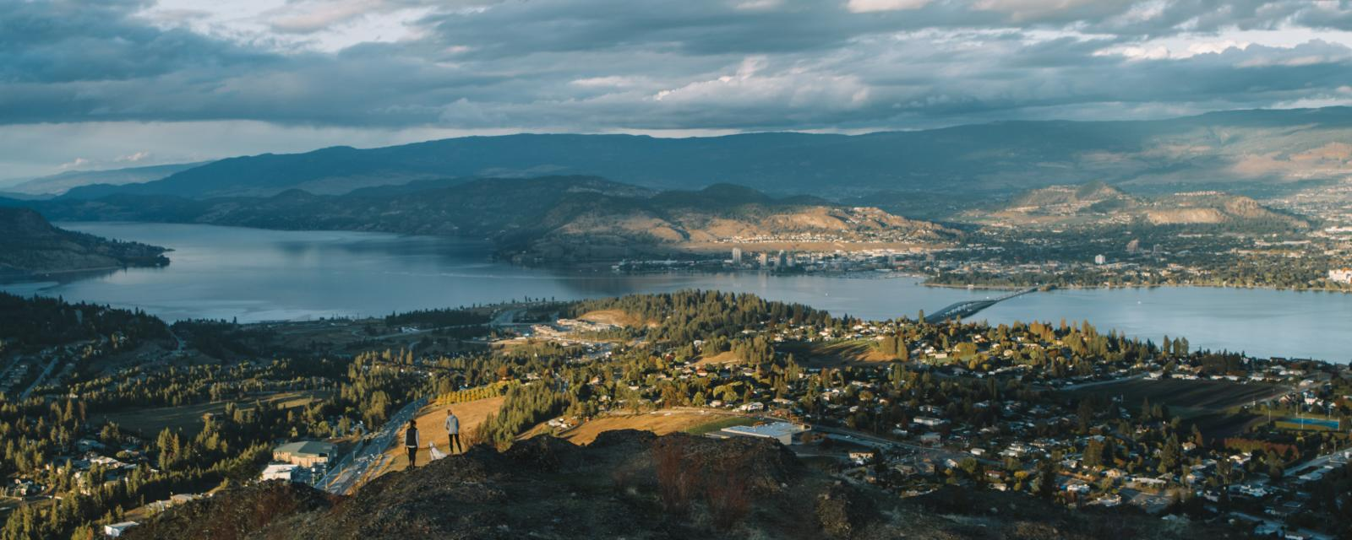
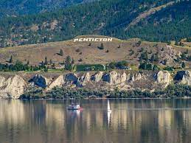
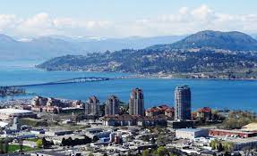
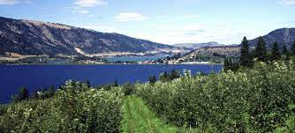
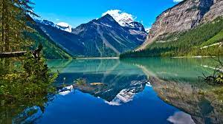
City
Kamloops - 33%
West Kelowna - 6%
Penticton - 5%
Kelowna - 32%
Lake Country - 6%
Other - 18%

Slide 6

Engagement by Age
Engagement by City
Kamloops
Other
Merritt
West Kelowna
Lake Country
Kelowna
36%
Senior
33%
Adult
31%
Young Adult
14%
Super Senior
30%
6%
4%
23%
4%
20%

Slide 7
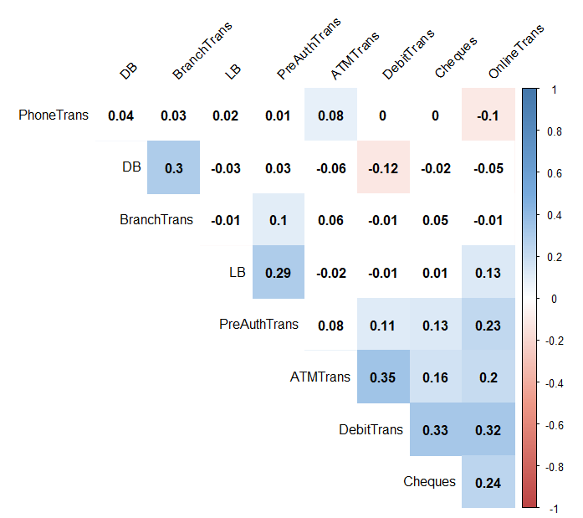
Correlation between Transactions
No Significant association between
different types of transactions
Correlation coefficient
ranges from -1 to 1

Slide 8
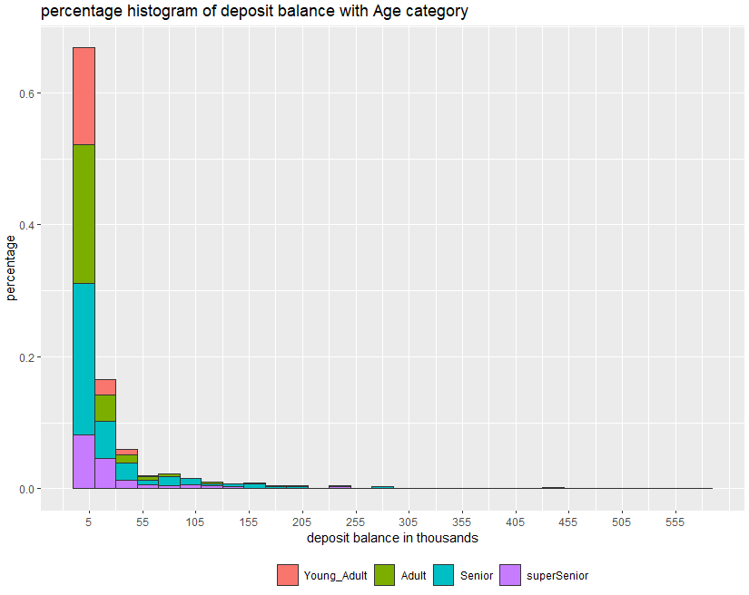
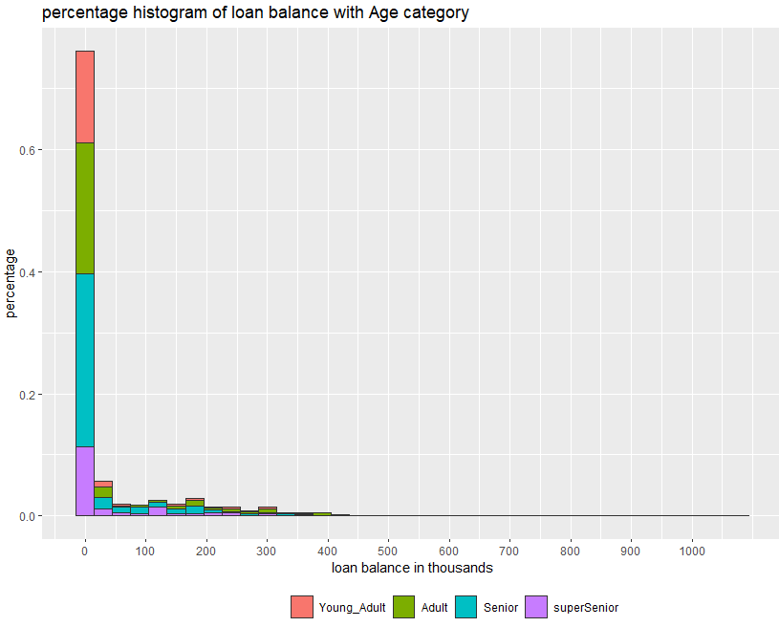
Distribution of Deposit and Loan balance
57% of customers
27.5% of Seniors
have a deposit balance < 5 thousand
have a loan balance of Zero
21% of Adults
23% of Seniors
20.6% of Adults
have a deposit balance of <5 thousand
have a loan balance of Zero

Slide 9
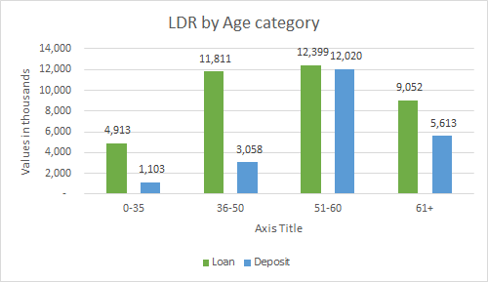
Loan to deposit ratio (LDR)
1.70 times LDR
Total
4.45 times LDR
Young adults
3.86 times LDR
Adults
1.61 times LDR
Super seniors
1.03 times LDR
Seniors

Slide 10
Research objective results

Slide 11
Research obective 1
Evaluate freely available external data sources (online) through secondary research, which could add value to study the company’s customer base.
Statistics Canada was selected as the optimal source for secondary data.
Data was extracted in xlsx format.
2016 census data based on the postal codes
Variables: median income, average income, median age, average age, average population, and median population.
All the variables were used for modeling.

Slide 12
Research obective 2
Analyze customers' behavior associated with various services offered by the company.
34% & 29% opted Wealth Management
37% & 24% opted Mortgage
from Kelowna & Kamloops
from Kelowna & Kamloops

Slide 13
Research obective 2cont.
33% & 28% opted Credit Card
36% & 30% of total Engagement
From Kelowna & Kamloops
From Kamloops & Kelowna
Okanagan Region has high density of customers and high engagement

Slide 14
Research obective 2cont.
Customer % by Service
Age Category % by Service

Slide 15
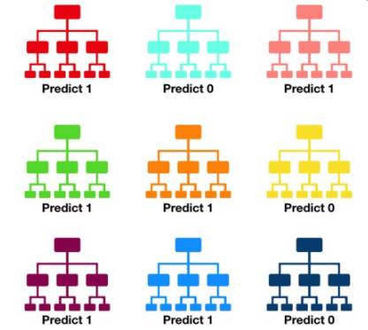
Research obective 3
Explore the degree to which a customer could subscribe to one or more company’s services.
Logistic and Random Forest (RF) algorithms were implemented
RF method was selected based on accuracy
Predictors in the model were Wealth management, Mortgage and Credit card

Slide 16
Research obective 3cont.
Wealth Management model
82%
Accuracy
Top 5 most important variables:
Number of products
Deposit balance
Number of online transactions
Tenure group
Age category
~31,000 CAD
Avg. annual income
150 trees
0.65
Precision
47,405 CAD
Avg. deposit balance
22 variables
0.87
Recall
4
Avg. number of products opted

Slide 17
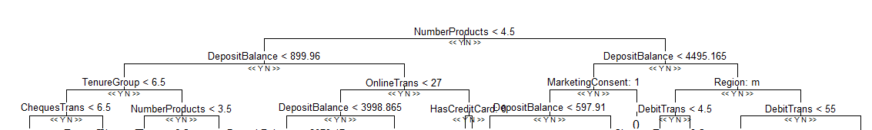
Research obective 3cont.
Mortgage model
78%
Accuracy
Top 5 most important variables:
Number of products subscribed by a customer
Deposit balance
Annual income after tax
Number of cheque
Online transactions
31,112 CAD
average annual income
200 trees
0.28
Precision
19 variables
18,722 CAD
mean deposit balance
0.38
Recall
5
mean number of products opted

Slide 18
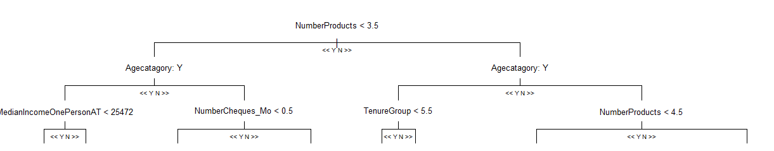
Research obective 3cont.
Credit card model
~74%
Accuracy
Top 5 most important variables:
Number of products
Age category
Number of ATM transactions
Online banking user
Statement type
22
Mean debit transactions
150 trees
0.73
Precision
19 variables
Young Adult & Senior
Major age categories
0.71
Recall

Slide 19
Research obective 4
Segment prospective customers to upsell / target Prospera’s products and services.
Kmeans, an unsupervised clustering technique was used to segment customers based on the variables, including deposit balance, loan balance, mortgage, credit card, payroll, wealth management, number of products, and tenure group.
The data was normalized to obtain better performing clusters, and four such clusters were recognized.

Slide 20
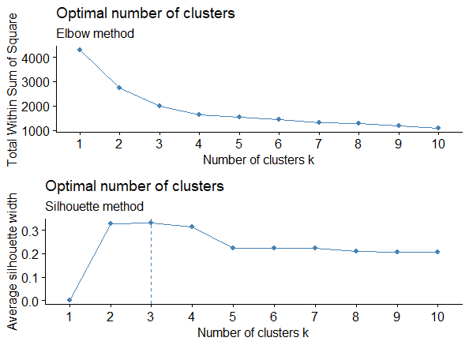
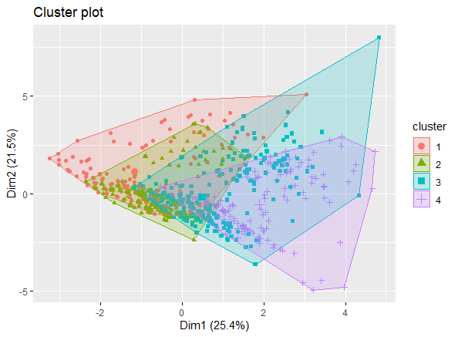
Research obective 4cont.
Optimal K plot
Cluster plot

Slide 21
Research obective 4cont.
Cluster 1
Cluster 2
Cluster size: 138
Median deposit balance: 1,265 CAD
Median loan balance: 25,877 CAD
Opted for very few services and has minimal engagement
Adults are dominating age group
Majority of customers are from Kelowna (28%) and Kamloops (27%)
Cluster size: 316
Median deposit balance: 1,451 CAD
Median loan balance: 5,878 CAD
Most opted services: wealth management and payroll
25% of total engagement
Seniors are dominating age group
Majority of customers are from Kamloops (36%) and Kelowna (25%)
Low deposit balance cluster
Low-Medium deposit balance cluster
Cluster 4
Cluster 3
Cluster size: 145
Median deposit balance: 15,060 CAD
Median loan balance: 41,760 CAD
Most opted services: wealth management, mortgage, and credit card
Seniors are dominating age group
Cluster opted for second highest number of products
Majority of customers are from Kelowna (36%) and Kamloops (28%)
Cluster size: 400
Median deposit balance: 3,530 CAD
Median loan balance: 11,268 CAD
Cluster has opted for high number of services and products
46% of total engagement
Seniors are dominating age group
Majority of customers are from Kelowna (34%) and Kamloops (30%)
High deposit balance cluster
Medium deposit balance cluster

Slide 22
Recommendations

Slide 23
Wealth management model identified 58 potential customers.
Narrowed to 9 customers after consideration of model error. 4 seniors, 2 adults and 3 young adults from Kelowna, Armstrong and chase.
Mortgage model identified 138 potential customers and narrowed to 6 clients based on key characteristics. They belong to senior age category and are from Kelowna and Lake Country.
39 possible clients for credit card and narrowed down to 11. Majority fall under young adult and seniors.
In cluster 1, loan amount is 20 times more than the deposit balance, which is the highest compared to other clusters. Its important to keep an eye on this cluster for any defaults or delinquencies.

Slide 24
Cluster 2 has second highest percentage of customers who signed up for payroll services, which means there are a greater number of working-class customers. These customers can be targeted for credit card as the percentage of customers opted for credit card is comparatively less (15%).
Cluster 3 is the most loyal customer base among the clusters. Customers in this cluster opted for maximum number of services and highest percentage of products. These customers can be targeted for wealth management as it the least opted service in the cluster, as well as the deposit balance is fairly affluent (3,530 CAD).
Cluster 4 has affluent customers with highest deposit balance. Customers in this cluster can be targeted for wealth management.
According to industry estimates, the Okanagan Valley real estate market is set to increase at 5% in 2021 . Besides, the average sales price in Kelowna for the year 2020 increased 5.6% to 553,175 CAD from 523,832 CAD in 2019. Target cluster 2 & 3 for mortgage services as majority of customers from those clusters are from Kelowna and other Okanagan cities.

Slide 25
Limitations

Slide 26
Clusters and size of each cluster might vary when new data points are introduced into the kmeans classification model .
The dataset was small to split into training, test and validation sets for model selection.
The census data is updated every 5 years. The company might need purchase or utilize recent estimated data.
Data inconsistency with date format as single type.

Slide 27
THANKS!
Any questions?
You can find us at
nitin.bh8@gmail.com / gschyd2016@gmail.com

Slide 28
Annexure

Slide 29
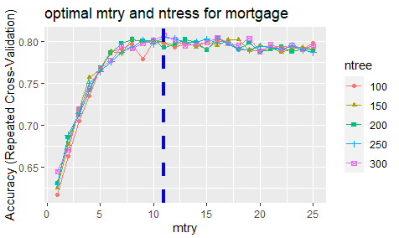
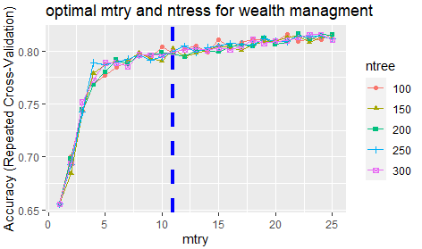
Random forest model

Slide 30
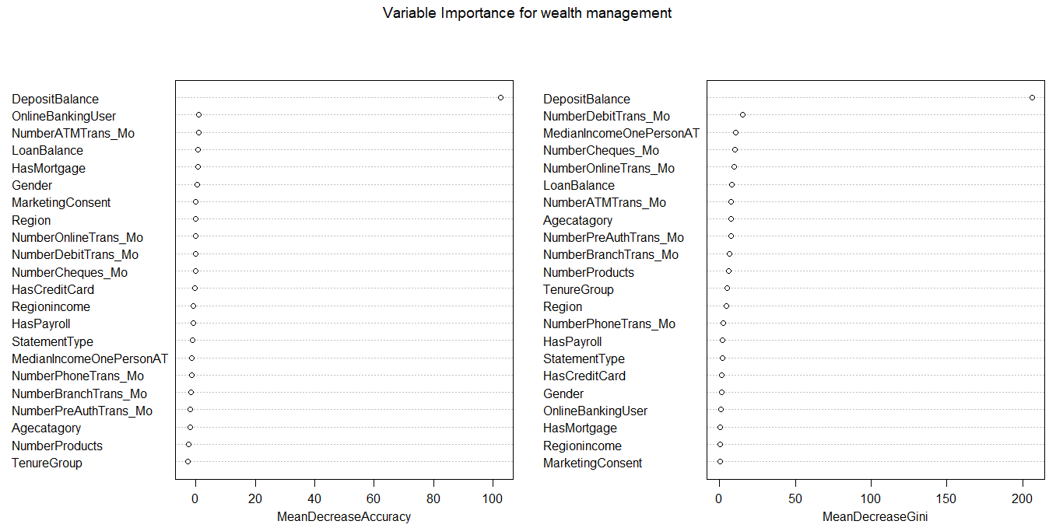
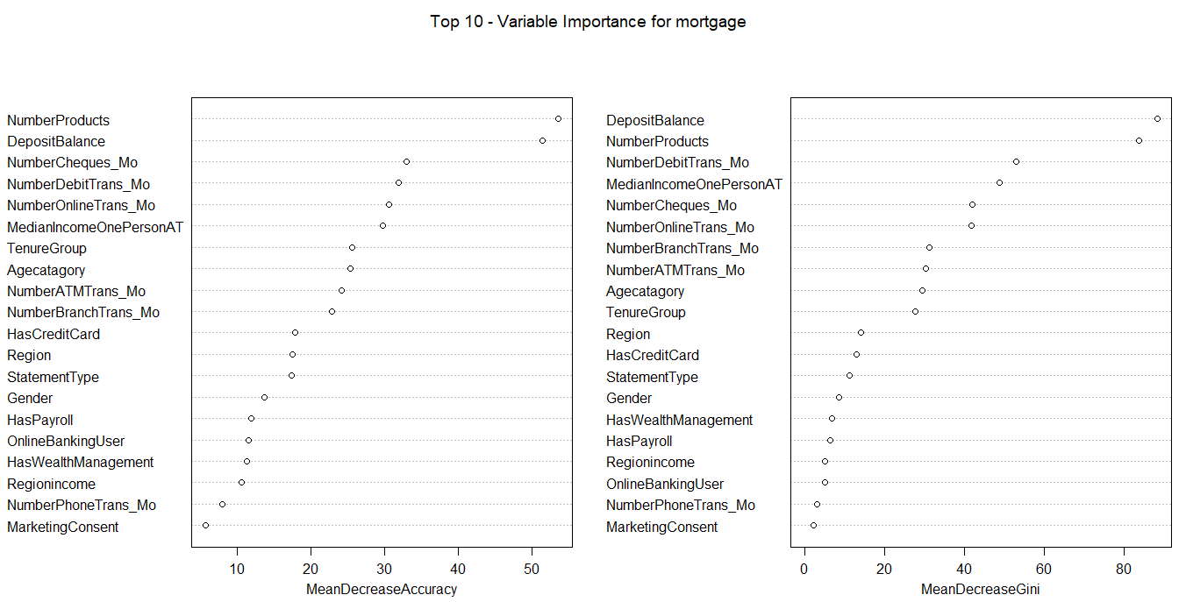
Important variables

Slide 31
Random forest model

